Slide 1
Combinatorics
Lecturer: Prof. Hejiao Huang (黄荷姣)
Tutors: Mr. Xinyuan Wang (王欣元）
Mr. Wanqiang Zeng （曾万强）
Mr. Yan Qin （秦琰）

Slide 2
Reference Books
Introductory Combinatorics, Prentice Hall, Richard A. Brualdi, 3rd edition, 5th edition

Slide 3
Assignments
There will be some assignments. They will be assigned after the end of a chapter and be due on “next” Wednesday.

Slide 4
Tutorials
Graduate student Teaching Assistants will be responsible for the tutorials. They will present examples, answer student questions, and return marked assignments. They will not present solutions to assignment problems before the deadline. However, they can do related examples, and can also answer some specific questions related to an assignment problem (without giving away the solution) provided the problem has been seriously attempted.

Slide 5
Examination
Close book. But some important formulas will be presented for you.
Final grade: Exam 70%, Assignments 30%.

Slide 6
Policy on Cheating
If you copy a classmate's assignment or permit a classmate to copy your assignment, you are cheating. If you have received help with an assignment problem, we expect that you will write out a solution in your own words, without ANY reference to written notes. If you are cheating, your mark will be 0.
Policy on Lectures and Assignments: Students are expected to attend all lectures and to submit all assignments for grading.

Slide 7
How do I get a good mark in this course?
Make the lecture time efficient. Listen to me carefully and solve the exercises in lecture time independently.
Give the assignments an honest effort. Their primary purpose is to help you learn the material. Don’t just show up to the tutorials or office hours fishing for answers. Try the problems first.

Slide 8
Our Information
Prof. Hejiao Huang (L1621)
Email: huanghejiao@hit.edu.cn
Tel: 26033487; 13632597055
Mr. Xinyuan Wang (L1516)
Mr. Wanqiang Zeng(L1516)
Mr. Yan Qin(L1616)

Slide 9
Assignment Submission
Electronic version：submit to账号： hitsz2024zhsx@163.com 。If you are writing homework on the workbook, please also take photos and organize them and send them to the designated mailbox。

Slide 10
Assignment Submission
Homework requirements: use the 学号_姓名_作业号 to name the assignment , for example: 24S151136_张三_第一次作业. If the formula is complex and handwritten to take pictures, it should also be placed in the document. It is recommended to submit the work in pdf format.

Slide 11
作业提交的相关要求
作业提交截止日期为布置作业当周的下周三上课前，逾期视为补交
作业题目应用全英文作答，需要包括完整的解答步骤
作业文件应提交 pdf 格式，尽量按照规范来命名：学号_姓名_作业号.pdf，其中作业号按次 数累加，如果一周内布置多章作业需要整理为一个文件提交，邮件主题最好也使用相同格式

Slide 12

Course Materials
扫一扫加入课程群
QQ group
Name: 24组合数学
Number：685161321

Slide 13
Summary
What is Combinatorics
The Application Areas of Combinatorics
Application Examples
Perfect Covers of Chessboards
Magic Squares
The four-Color Problem
The problem of the 36 Officers
Shortest Route Problem
The pigeonhole principle
Permutations and Combinations
IP Address Example
Conclusion

Slide 14
What is Combinatorics
Combinatorics is concerned with the existence, enumeration, analysis, and optimization of discrete structure.

Slide 15
Existence of the Arrangement
A set of objects are arranged such that certain requirements are satisfied.
Is the arrangement always possible?
If the answer is “no”, what are the additional conditions?

Slide 16
Enumeration or Classification of the Arrangement
A specified arrangement is possible and there are several ways of achieving it.
Count their number
Classify them into types

Slide 17
Study of a Known Arrangement
After an arrangement satisfying certain requirements has been constructed
Investigate the properties and structures
Whether the structure has implications for the classification problem
Whether it has potential applications?

Slide 18
Construction of an Optimal Arrangement
More than one arrangement is possible.
Find a best or optimal arrangement in some prescribed sense.

Slide 19
The Application Areas of Combinatorics
Physical science (with the application of traditional mathematics)
Social science
Biological sciences
Information theory
etc.

Slide 20
Perfect Covers of Chessboards
This problem equals to dimer problem in molecular physics.
Squares --- molecules
Dominoes --- dimers （二聚物）

Slide 21
Perfect Covers of Chessboards
Cut out two diagonally corner squares, is it possible to arrange 31 dominoes to obtain a perfect cover of this “pruned” board?

Slide 22
Magic Square
Is a n-by-n array constructed out of the integers 1,2,…..n² in such a way that the sum of the integers in each row, in each column, and in each of the two diagonals is the same number s.
8 | 1 | 6
3 | 5 | 7
4 | 9 | 2

Slide 23
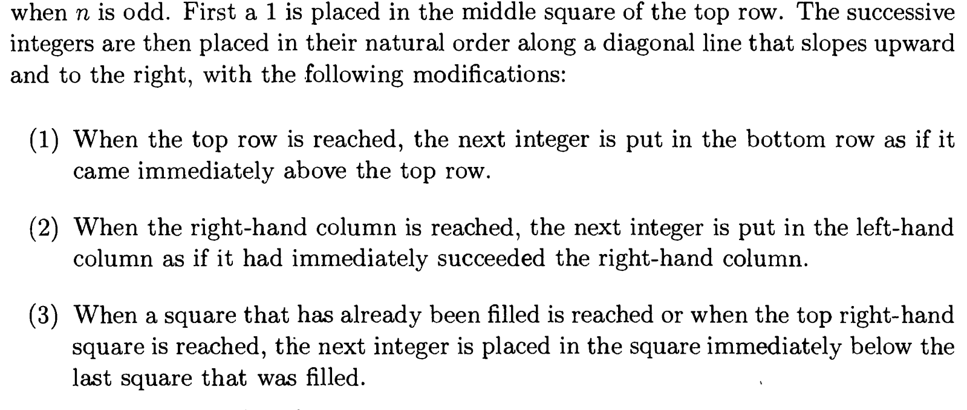
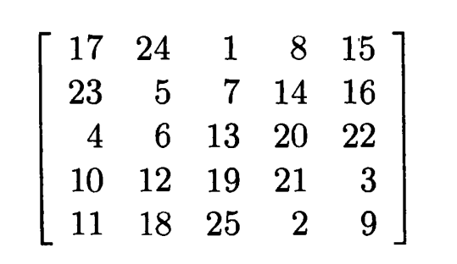
Constructing magic squares of order n

Slide 24
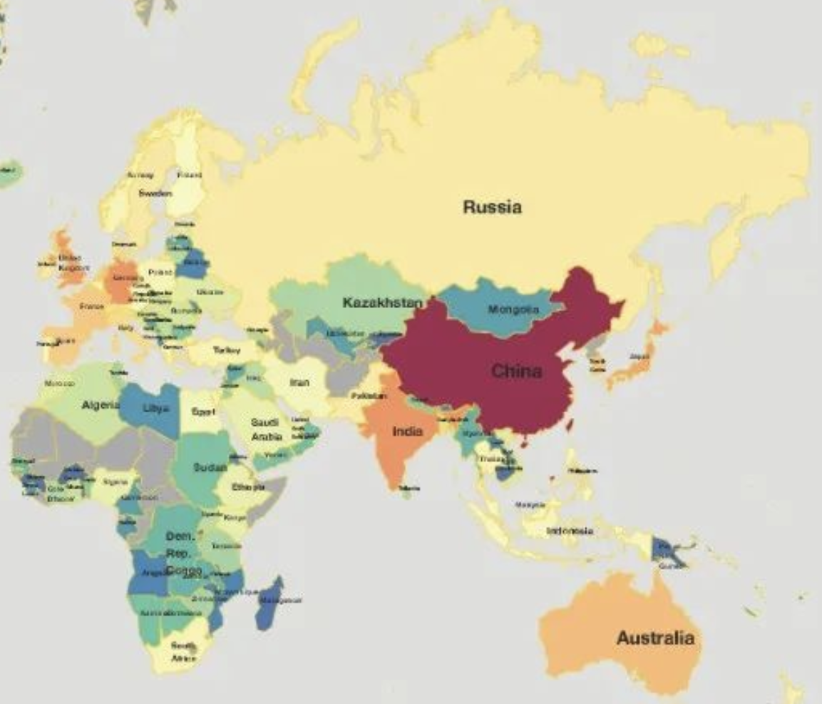
The Four-Color Problem
In communication networks, the wavelength assignment problem can be converted to coloring problems.

Slide 25
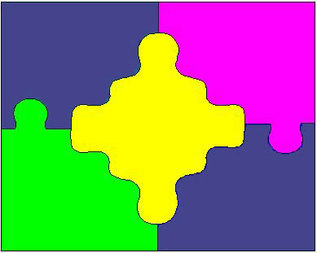
三、四色问题
四色问题是世界近代三大数学难题之一。
四色问题的内容是：任何一张地图只用四种颜色就能使具有共同边界的国家着上不同的颜色。
它的提出来自英国。1852年，毕业于伦敦大学的弗南西斯·格思里(Guthrie)发现了一种有趣的现象：“看来，每幅地图都可以用四种颜色着色，使得有共同边界的国家都被着上不同的颜色。”这个现象能不能从数学上加以严格证明呢？

Slide 26
1872年，英国当时最著名的数学家凯利正式向伦敦数学学会提出了这个问题，于是四色猜想成了世界数学界关注的问题。
1878～1880年两年间，著名的律师兼数学家肯普和泰勒两人分别提交了证明四色猜想的论文，宣布证明了四色定理，大家都认为四色猜想从此也就解决了。
1890年，在牛津大学就读的年仅29岁的赫伍德以自己的精确计算指出了肯普在证明上的漏洞。不久，泰勒的证明也被人们否定了。后来，人们开始认识到，这个貌似容易的题目，其实是一个可与费马猜想相媲美的难题。

Slide 27
进入20世纪以来，科学家们对四色猜想的证明基本上是按照肯普的想法在进行。后来美国数学家富兰克林于1939年证明了22国以下的地图都可以用四色着色。1950年，有人从22国推进到35国。1960年，有人又证明了39国以下的地图可以只用四种颜色着色；随后又推进到了50国。
1976年6月，美国伊利诺大学哈肯与阿佩尔在两台不同的电子计算机上，用了1200个小时，作了100亿判断，终于完成了四色定理的证明，轰动了世界。
然而，真正数学上的严格证明仍然没有得到！数学家仍为此努力，并由此产生了多个不同的图论分支。

Slide 28
The Problem of 36 Officers
Applied to statistics:
e.g., suppose 7 varieties of products need to be tested by 7 consumers. Each consumer is asked to compare a certain 3 of the varieties. The test is to have a property that each pair of the 7 varieties is compared by exactly one person. Can such a testing experiment be designed?
1 | 2 | 3
3 | 1 | 2
2 | 3 | 1
1 | 2 | 3
2 | 3 | 1
3 | 1 | 2
(1,1) | (2,2) | (3,3)
(3,2) | (1,3) | (2,1)
(2,3) | (3,1) | (1,2)

Slide 29
Shortest-Route Problem
Graph theory is applied to psychology, sociology, chemistry, genetics and communications science.
e.g., vertex --- people
edge --- people distrust each other
vertex --- atoms
edge --- bonds between atoms
2
x
1
1
2
1
1
y
1
1
1
2

Slide 30
The Pigeonhole Principle
Ex1.
Ex2.
8 apples
6 oranges
Sum of ages
＝
Sum of ages
9 bananas
How many fruits?
10 people in two groups
Age ∈ [1, 60]

Slide 31
Permutations and Combinations
For n teams, each team played every other team exactly once, how many games the n teams would play?
100 students, 3 dormitories with capacities 25, 35 and 40 respectively. How many ways to fill the dormitories?

Slide 32
IP Address Example
Some facts about Internet Protocol:
Valid computer addresses are in one of 3 types:
A class A IP address contains a 7-bit “netid” ≠ 1⁷, and a 24-bit “hostid”
A class B address has a 14-bit netid and a 16-bit hostid.
A class C addr. Has 21-bit netid and an 8-bit hostid.
The 3 classes have distinct headers (0, 10, 110)
Hostids that are all 0s or all 1s are not allowed.
How many valid computer addresses are there?

Slide 33
IP Address Solution
# class A = (# valid netids)·(# valid hostids)
(by product rule)
(# addrs) = (# class A) + (# class B) + (# class C)
(by sum rule)
(# valid class A netids) = 2⁷ − 1 = 127.
(# valid class A hostids) = 2²⁴ − 2 = 16,777,214.
Continuing in this fashion we find the answer is: 3,737,091,842 (3.7 billion IP addresses)

Slide 34
Conclusion
With combinatorics, as with mathematics in general, the more problems one solves, the more likely one is able to solve the next problem.
Notes:
1。Given a broadcast/multicast, to determine broadcast/multicast tree(power of each node) such the total cost is minimized.
BIP(Broadcast Incremental Power), MIP, MST,SPT have been proposed. Performance through simulation.
2.3。 Each node have k levels power. To determine power level of each node, such that total cost of broadcast is minimized.
For 3, Heuristic algorithm based directed Steiner tree method was proposed.
Our work is similar with 2,, but our algorithm is better than 2.

